Slide 1
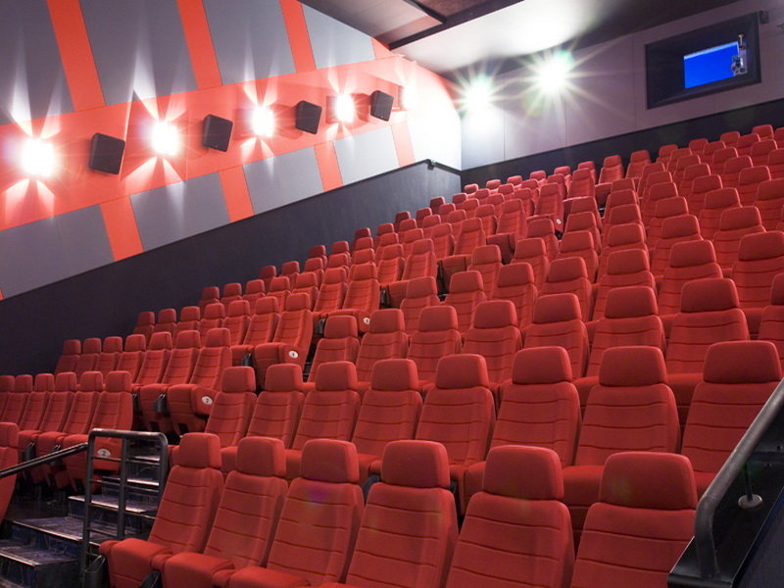
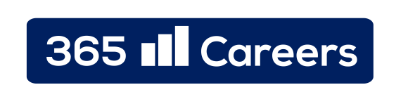

Kinemax – Case Study
Company presentation

Slide 2
Index
1
Group Structure
3
2
Historical Timeline
4
3
Business Formula
5
4
Geographical Footprint
6
5
Country Comparison
7
6
Future Growth Prospects
8
7
Financials at a Glance
9
8
Summary Table
10

Slide 3
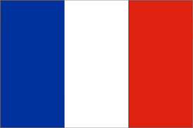





Group structure
Historical Timeline
Business Formula
Geographical footprint
Country Comparison
Future Growth Prospects
Financials at a Glance
Summary Table
Group Structure
Kinemax Group:
Kinemax Group
Kinemax Sarl was founded in 2009 by a prominent French entrepreneur. The company owns a chain of cinema multiplexes, targeted at children audiences. Kinemax tries to take advantage of the fastest growing niche within the cinema market
International expansion
Soon after the company started its operations in France, it started looking abroad. Currently, the company is present in 5 foreign markets – mainly in Europe
Two of Kinemax’s most recent investments are related to the fast growing markets of Turkey and Brazil. The company owns a majority stake in its investment in Turkey (80%), and decided to form a Joint Venture in order to access the Brazilian market
Structure of the Group
Kinemax Sarl, the French legal entity, is the Group’s owner. The company has direct participation in all of the other companies
Kinemax consolidates fully all of its subsidiaries, given that the company is the major shareholder in all five of them and is able to exercise control
Accounting principles
All legal entities within the Kinemax Group prepare their financial figures under IFRS
Kinemax Sarl
2009
Kinemax
Italia Spa
*100%
Kinemax
UK Ltd
*100%
2010
2010
Kinemax Deutschland
Saar
*100%
Kinemax
Turkey A.S
*80%
2011
2011
Kinemax
Brazil
LTDA
*49%
2011
Legend:
Kinemax Group perimeter
Joint Venture
Parent company
*%
Percentage held by
the Parent Company
Subsidiaries

Slide 4
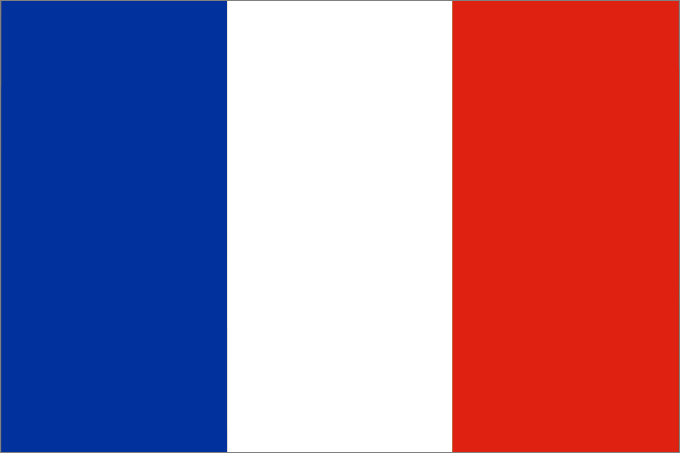







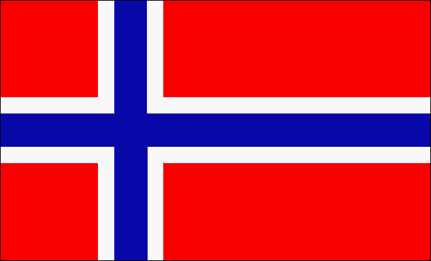




Group structure
Historical Timeline
Business Formula
Geographical footprint
Country Comparison
Future Growth Prospects
Financials at a Glance
Summary Table
Historical Timeline
Company was founded
Country
Opening
Country
Opening
Country
Opening
Country
Opening
Country
Opening
Future developments
June
2009
February
2010
November
2010
March
2011
July
2011
November
2012
Financing, 2009
Financing, 2010
Financing, 2012
New Service Line, 2014
First Round
€50 million
Second Round
€50 million
Third Round
€40 million
Third Round
€40 million
Acquisition
Second Round
€50 million

Slide 5
Group structure
Historical Timeline
Business Formula
Geographical footprint
Country Comparison
Future Growth Prospects
Financials at a Glance
Summary Table
Business Formula
Target a Niche Market
International Presence
Access Growth Markets
Extended Service Line
Kinemax’s
Business Model
Partnership with Local Players
Strong Bargaining Power
Organize Promotional Events
Leverage Customer Behavior

Slide 6
Group structure
Historical Timeline
Business Formula
Geographical footprint
Country Comparison
Future Growth Prospects
Financials at a Glance
Summary Table
Geographical Footprint

Slide 7
Group structure
Historical Timeline
Business Formula
Geographical footprint
Country Comparison
Future Growth Prospects
Financials at a Glance
Summary Table
Country Comparison

Slide 8
Group structure
Historical Timeline
Business Formula
Geographical footprint
Country Comparison
Future Growth Prospects
Financials at a Glance
Summary Table
Future Growth Prospects

Slide 9
Group structure
Historical Timeline
Business Formula
Geographical footprint
Country Comparison
Future Growth Prospects
Financials at a Glance
Summary Table
Financials at a Glance

Slide 10
Group structure
Historical Timeline
Business Formula
Geographical footprint
Country Comparison
Future Growth Prospects
Financials at a Glance
Summary Table
Summary Table

